Slide 1
Syntactic Processing

Slide 2
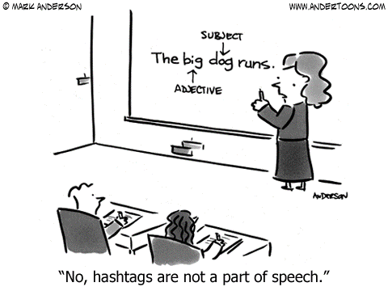
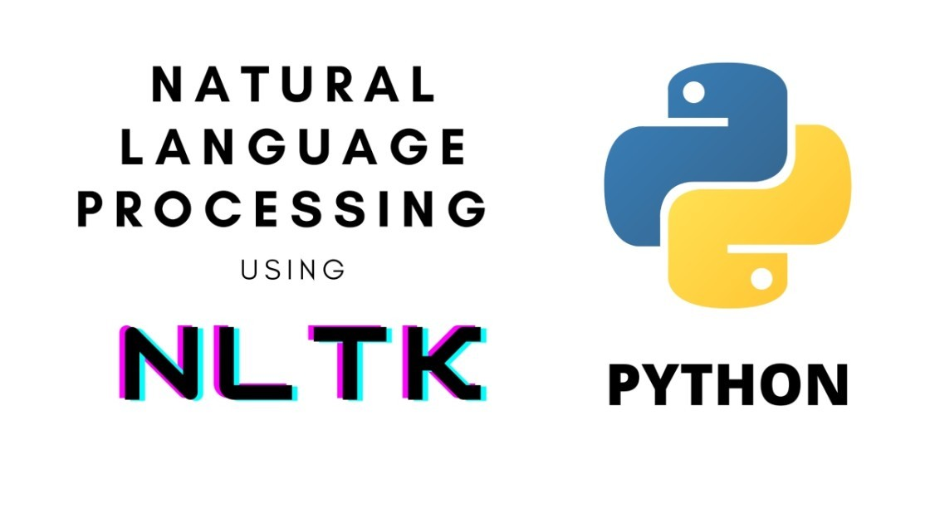
NLTK
NLTK, or the Natural Language Toolkit, is a powerful library in Python for working with human language data (text). It provides easy-to-use interfaces to over 50 corpora and lexical resources such as WordNet, along with a suite of text processing libraries for classification, tokenization, stemming, tagging, parsing, and semantic reasoning, wrappers for industrial-strength NLP libraries, and an active discussion forum.

Slide 3
Key Features:
Corpora and Lexical Resources: Access to various text corpora and lexical resources.
Gutenberg: Contains text from classic literature.
Brown: The first million-word electronic corpus of English.
Reuters: A collection of news documents.
Inaugural: Presidential inaugural speeches.
Text Processing Libraries: Tools for classification, tokenization, stemming, tagging, parsing, and semantic reasoning.
API for Industrial NLP Libraries: Wrappers for industrial-strength NLP libraries.
Educational Tools: Extensive documentation and tutorials for learning and teaching computational linguistics and natural language processing.

Slide 4
Corpus
A corpus (plural: corpora) is a large and structured set of texts (now usually electronically stored and processed) used for linguistic research and language technology development. Corpora are essential for various NLP tasks as they provide the raw data needed for analysis, training models, and evaluating algorithms.

Slide 5
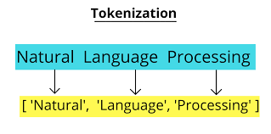
Tokenization
Tokenization refers to break down the text into smaller units. It entails splitting paragraphs into sentences and sentences into words. It is one of the initial steps of any NLP pipeline.
Work Tokenization
It involves breaking down the text into words.
"I study Machine Learning on GeeksforGeeks." will be word-tokenized as
['I', 'study', 'Machine', 'Learning', 'on', 'GeeksforGeeks', '.'].
Sentence Tokenization
It involves breaking down the text into individual sentences.
Example:
"I study Machine Learning on GeeksforGeeks. Currently, I'm studying NLP"
will be sentence-tokenized as
['I study Machine Learning on GeeksforGeeks.', 'Currently, I'm studying NLP.']

Slide 6
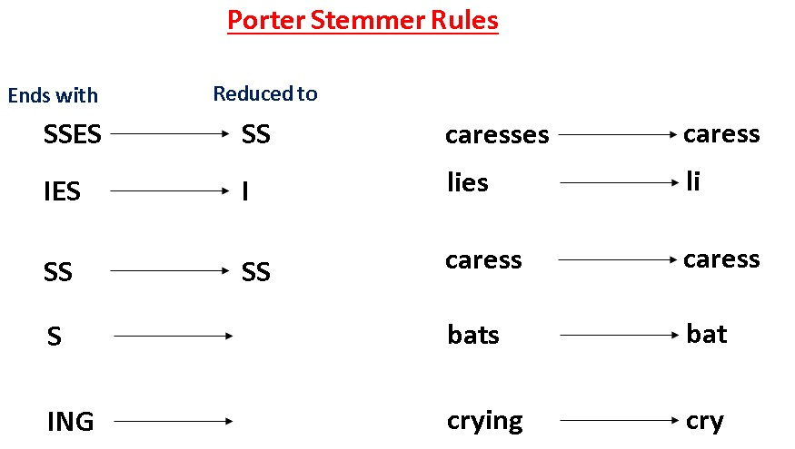
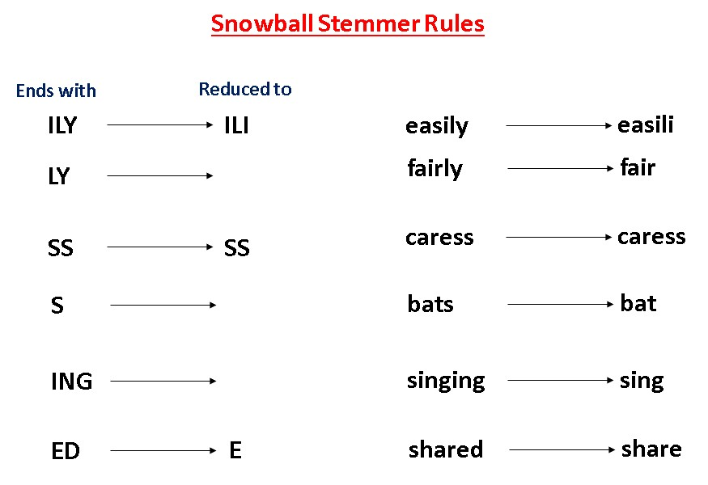
Stemming and Lemmatization
When working with Natural Language, we are not much interested in the form of words – rather, we are concerned with the meaning that the words intend to convey. Thus, we try to map every word of the language to its root/base form. This process is called canonicalization.
Stemming generates the base word from the inflected word by removing the affixes of the word. It has a set of pre-defined rules that govern the dropping of these affixes. It must be noted that stemmers might not always result in semantically meaningful base words. Stemmers are faster and computationally less expensive than lemmatizers.

Slide 7
Lemmatization
Lemmatization is a more sophisticated technique than stemming in the sense that it doesn’t just chop off the suffix of a word. Instead, it takes an input word and searches for its root word by going recursively through all the variations of dictionary words. The base word, in this case, is called the lemma.
Words such as ‘feet’, ‘drove’, ‘arose’, ‘bought’, etc. can’t be reduced to their accurate base form using a lemmatizer. The most popular lemmatizer is the WordNet lemmatizer created by a team of researchers at the Princeton university.

Slide 8
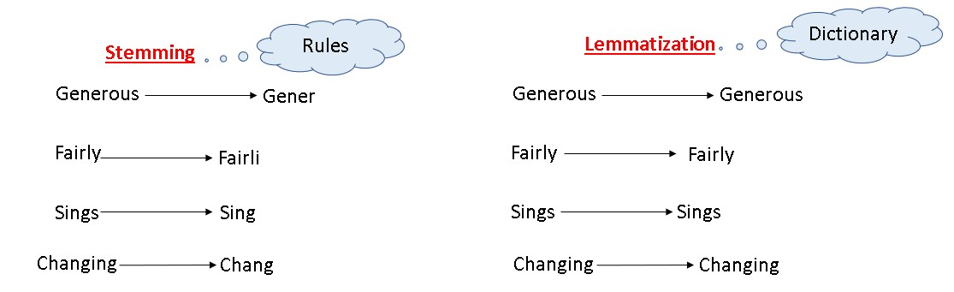
Stemming and Lemmatization

Slide 9
POS Tagging
POS tagging is the process of marking up a word in a text (corpus) as corresponding to a particular part of speech, based on both its definition and its context—i.e., its relationship with adjacent and related words in a phrase, sentence, or paragraph. Some common POS tagging schemes include the Penn Treebank tagset and the Universal Dependencies tagset.
Text: “The cat sat on the mat.”
POS tags:
The: determiner
cat: noun
sat: verb
on: preposition
the: determiner
mat: noun
POS Tagging - https://www.guru99.com/pos-tagging-chunking-nltk.html

Slide 10
Steps Involved in the POS tagging example
Tokenize text (word_tokenize)
apply pos_tag to above step that is nltk.pos_tag(tokenize_text)
Significance of POS Tagging:
Syntax Parsing: POS tags are essential for syntactic parsing, which is crucial for understanding the structure of a sentence.
Information Retrieval: Helps in the retrieval of relevant information by understanding the context of words.
Word Sense Disambiguation: Assists in identifying the correct meaning of a word based on its use in a sentence.
Named Entity Recognition (NER): Aids in recognizing proper nouns and other named entities in text.
Text-to-Speech Systems: Improves the pronunciation and intonation in text-to-speech applications.

Slide 11
Chunking
Chunking is the process of dividing words into chunks depending on their syntactic form. It recognizes and extracts specified patterns or phrases from a sentence or text document.
NLTK supports flexible chunking, allowing users to construct patterns using regular expressions or preset grammar, such as noun phrase chunking and verb phrase chunking.
Noun phrase is built around a noun e.g., “A new laptop”.
Verb phrase is built around a verb e.g., “Bought a new laptop”.
It uses parts-of-speech (POS) tags to group words and apply chunk tags to the group of words. Because chunks can not overlap, a single occurrence of a word can appear in only one chunk at a time.

Slide 12
Chunking Patterns
We will be using these chunking patterns in our coding example.
chunk_patterns = r"""
NP: {<DT>?<JJ>*<NN>}
VP: {<VB.*><NP|PP>}
"""
Chunking patterns used for noun and verb phrases
NP represents the noun phrase chunk pattern. It uses an optional determiner (DT), followed by zero or more adjectives (JJ), and a noun (NN).
VP represents the verb phrase chunk pattern. It uses a verb (VB followed by any suffix .*), followed by a noun phrase (NP) or a prepositional phrase (PP).
Note: A chunk grammar is a combination of rules on how sentences should be chunked. It often uses regular expressions, or regexes.Furthermore, NLTK provides a module called nltk.chunk that includes the RegexpParser class, which allows to define chunk patterns using regular expressions.

